Slide 1
Generative AI & LLM in Practice
Kishoreraj Jayakumar

Slide 2













Self Introduction
Kishoreraj Jayakumar
| Full Stack & Gen AI Engineer |
https://www.linkedin.com/in/jkishoreraj/

Slide 3

Agenda:
Gen AI Introduction
Gen AI Usage & Platforms
LLM Overview
Prompt Engineering
Prompting Techniques
RAG
Agentic AI
Short Demo

Slide 4
Beginner Questions
What is Gen AI?
How Gen AI works?
How to talk to an LLM?
How can custom knowledge be provided to LLM?
How to use LLM for Autonomous Use cases?

Slide 5
Generative AI in AI/ML
Artificial Intelligence
Machine Learning
This is the overarching concept, aiming to create machines capable of performing tasks that typically require human intelligence, such as understanding language, recognizing images, and making decisions
A subset of AI, ML focuses on algorithms that allow computers to learn from data without being explicitly programmed.
Deep Learning
A further specialization within ML, DL uses artificial neural networks with multiple layers (deep neural networks) to analyse data and identify complex patterns.
Generative AI
A type of AI that uses deep learning techniques to create new content, such as text, images, music, or video, based on learned patterns from existing data.

Slide 6
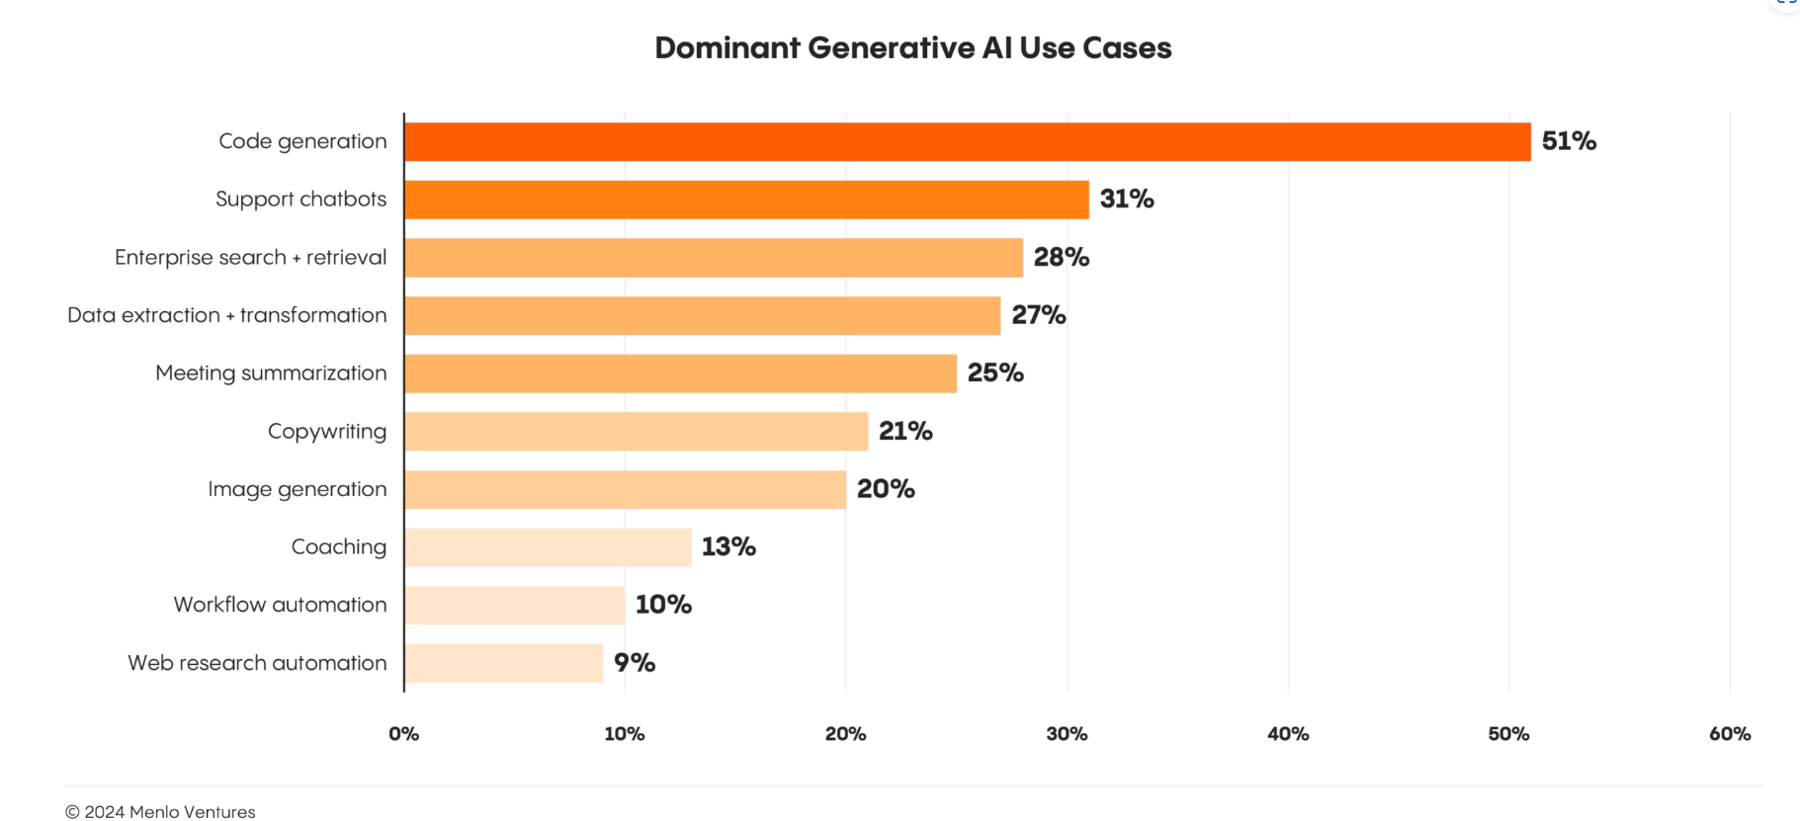
Generative AI Use Cases

Slide 7








Generative AI Chatbots
some of the famous Gen AI Chatbots
Owned By: Open AI Models: GPT-3*,GPT-4*,GPT-O* | Owned By: Open AI Models: DALL.E-2, DALL.E-3
Owned By: Microsoft Models: GPT-4* | Dev By: GitHub & Open AI Models: DALL.E-2, DALL.E-3
Owned By: Meta Models: Llama 3.2, Llama 3.1 -405B | Owned By: Anthropic Models: Haiku, Sonnet, Opus
Owned By: Google Models: Gemini -1.5 & 2.0 (Flash/Pro/Lite) | Owned By: Perplexity AI Models: sonar pro/reasoning
META AI

Slide 8






Gen-AI App – High-Level Design
LLM SERVICE API
User Question in Natural Language
Chatbot GUI Application
chatbot APP API Server
LARGE LANGUAGE MODEL
APP Database

Slide 9
Large Language Models (LLMs)
AI/ML Model built with deep learning techniques
Neural network model trained with massive data
Understands, interprets, and generates human-like text
Mostly uses transformers architecture, and undergoes curation, and tokenization processes while training
Knowledge level is commonly identified by “parameters”,
Ex: Llama 8B , gemma 27B
Widely used for text generation, language translations, chatbots, summarization and data reasoning, etc.,
Also, multimodal LLMs are used for text, image, audio, video generation and interpretations

Slide 10
LLM Development Overview
Data Collection & Curation
Fine Tuning, For Specific Use Cases
Release, Deployment and Service
Identify Model Architecture GPT, BERT, etc.
Training & Optimization
Monitoring & Improvement

Slide 11
Open Vs Closed source LLMs
Aspect | Open-Source LLMs 🛠️ | Closed-Source LLMs 🔒
Access | Free to use, modify, and distribute | Restricted access, proprietary licenses
Transparency | Fully transparent, code and training data available | Opaque, internal algorithms and data not disclosed
Customization | Fully customizable for specific needs | Limited customization (depends on API features)
Deployment | Can be deployed on-premise or in a private cloud with GPUs by ourselves | Hosted by provider, SaaS-based API access
Data Privacy | Full control over data and model usage | Data may be logged or used for improvement
Security | User-controlled security measures | Provider ensures security, but data exposure risks exist
Cost | Free to use, but infrastructure costs apply | Typically pay-per-use or subscription-based
Performance | Varies based on hardware and optimization | Generally well-optimized and high-performing
Scalability | Requires own infrastructure for scaling | Scales easily with provider’s cloud infrastructure
Community Support | Strong open-source communities (Hugging Face, Meta, Mistral) | Limited, mostly official support
Regulatory Compliance | Easier to ensure compliance by self-hosting | Compliance depends on provider’s policies
Updates & Maintenance | Requires manual updates and improvements | Automatically updated by provider
Examples | LLaMA, Mistral, Falcon, GPT-NeoX, BLOOM | GPT-4, Gemini, Claude, CoPilot

Slide 12




LLM Integration - Key Techniques:
Crafting Effective Inputs
Providing External Data
Customizing a Pre-trained LLM
Enabling LLM response to trigger actions
Agentic AI
Fine-Tuning
Retrieval Augmented
Generation
Prompt
Engineering

Slide 13

Prompt
A prompt is a query, command, or statement guiding the LLM to generate a desired output
The LLM model analyzes the prompt and uses its training data to produce a response that is relevant and appropriate to the prompt.
Prompt Engineering
The art and science of crafting input prompts to maximize the quality of output from language models.
Sets the context and intention
Directly influences model accuracy and relevance.
It improves communication between humans and machines, ensuring the resulting interaction is efficient and effective.

Slide 14
Why Does Prompt Engineering Matter?
Precision: Reduces ambiguity in model output.
Efficiency: Minimizes trial-and-error cycles.
Adaptability: Tailors responses to specific domains.
Example: "Summarize this text" vs. "Summarize this text in 3 bullet points for a business audience."

Slide 15







Prompting Elements
Different sections of a prompt, helps in guiding LLM for a desired response
Persona, Context
Instructions
Examples
Input Data
Constraints
Tone
Format

Slide 16
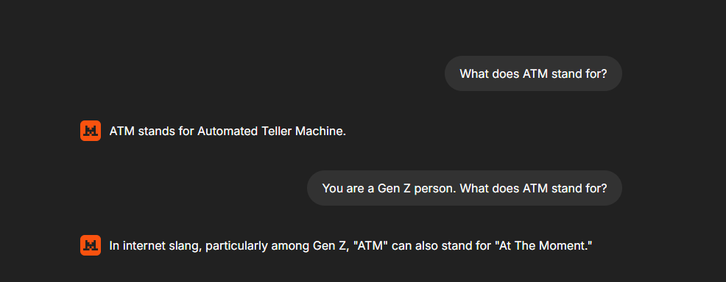
Prompt Structure
Role

Slide 17
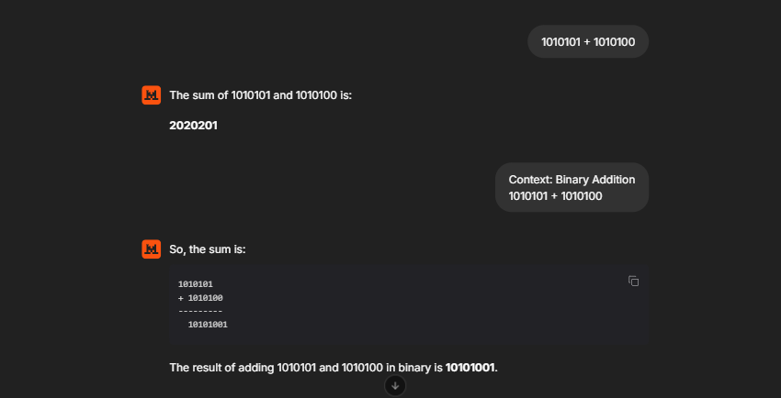
Prompt Structure
Context

Slide 18
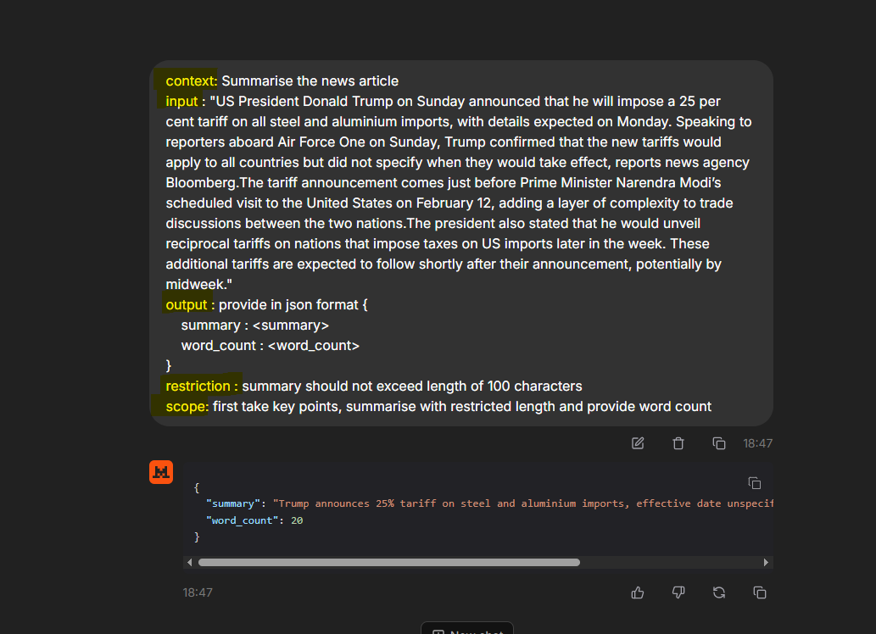
Prompt Structure
Final Example

Slide 19
Prompting Techniques
Different ways of crafting prompts based on requirements
Zero Shot
Direct questions without any examples
Example: “Explain black hole in simple terms”
Few Shot
Role Based
Chain of Thought
Self Consistent – COT
i
Tree of Thought
Provide a few examples before asking the model to generate a response
Example: *"Translate the following: 1. Hello → Hola 2.Thank you → Gracias 3.Good night → ???"*
Response: "Buenas noches."
Assigning a specific role to the AI for contextual responses.
Example: "You are a South Indian grandmother. Explain why filter coffee is the best.“
Response: "Ayyo! Nothing beats fresh decoction and thick milk—better than any machine coffee!"
Encourages step-by-step reasoning before answering.
Example: "If a train moves at 50 km/h for 3 hours, how far does it go? Think step by step.“
Response: "Step 1: Speed = 50 km/h - Step 2: Time = 3 hours Step 3: Distance = Speed × Time = 50 × 3 = 150 km."
The model generates multiple CoT answers for n iterations of CoT prompts and picks the most consistent one
Use Case: Mathematical problems, logic puzzles, and complex decision-making.
Instead of a single CoT path, the model branches into multiple reasoning paths, evaluates them, and picks the best.
Example: "How can I prepare for my college final exams effectively? Think in multiple ways before deciding the best approach.“
Response: "Path 1: Structured Study Plan, Path 2: Group Study Approach , Path 3: Visual & Memory Techniques150 km."

Slide 20
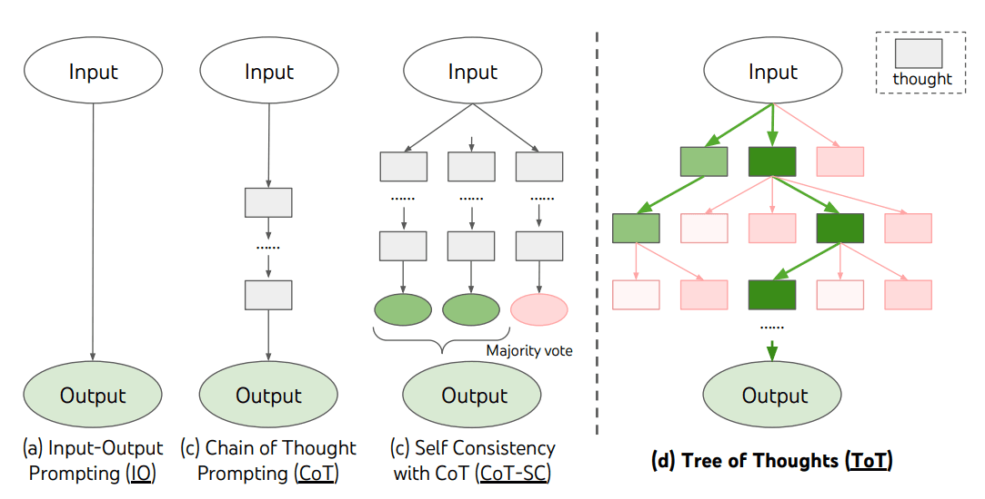
Prompting Illustrations

Slide 21
Prompting – Output Controlling Attributes
Parameter | Definition | Effect | Value Range | Use Cases
Temperature 🌡️ | Controls randomness in responses. | Lower values (0.1-0.5) make responses deterministic, higher values (0.7-1.5) increase creativity. | 0.0 to 2.0 | Code generation (low), Creative writing (high)
Top-k Sampling 🎯 | Limits word selection to the k most probable words. | Lower k makes responses focused, higher k makes them diverse. | 1 to 100 | Factual answers (low k), Storytelling (high k)
Top-p Sampling 🏆 | Chooses words based on cumulative probability. | Lower p makes responses conservative, higher p allows more diverse outputs. | 0.0 to 1.0 | Formal writing (low p), Casual conversations (high p)
Frequency Penalty 🔁 | Reduces repetition of frequently used words. | Higher values discourage repeated phrases. | 0.0 to 2.0 | Prevents repetitive responses in essays, articles
Max New Tokens 📝 | Limits the number of generated tokens (words). | Higher values allow longer responses, lower values keep them concise. | 10 to 4096+ | Short summaries (low), Long-form writing (high)

Slide 22




Prompting Demo

Slide 23

Retrieval Augmented Generation (RAG)

Slide 24


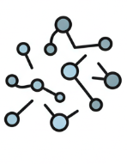
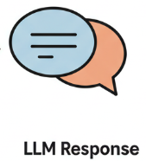
Retrieval Augmented Generation (RAG)
What?
RAG is an AI technique that enhances text generation by retrieving relevant external knowledge before generating responses
Why?
Traditional LLMs rely only on pre-trained knowledge, which can become outdated. RAG dynamically retrieves up-to-date information, ensuring more factual and context-aware responses.
When?
It is used when AI needs to answer domain-specific, dynamic, or real-time queries, such as legal, medical, or technical support
Where?
Commonly applied in customer service chatbots, enterprise knowledge retrieval, AI search engines, and research assistants that require factual grounding.
How?
RAG first retrieves the most relevant data from a vector database or document store and then uses an LLM to generate an informed response, improving accuracy and reducing hallucinations.

Slide 25
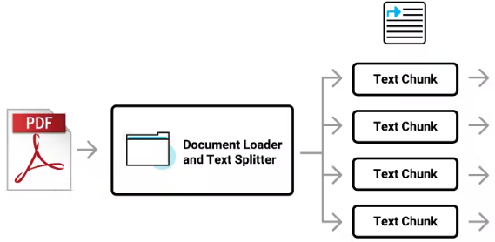
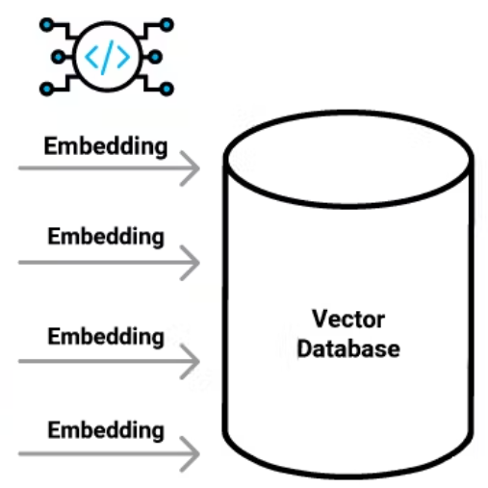
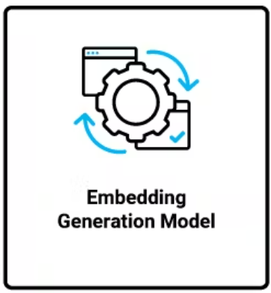
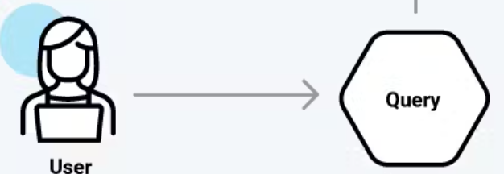

RAG Implementation
Ingestion Stage
Similarity Search
Query Embeddings
+
Document Chunks Related to User Query
Inference Stage
Top Matches
Inference LLM
LLM Response

Slide 26

DEMONSTRATION

Slide 27

AGENTIC AI

Slide 28


Agentic AI
Extending LLM capabilities with AI Agents
Tools & APIs
AI Agents
LLM
Agentic AI is a software system designed to interact with data and tools in a way that requires minimal human intervention.
Agentic AI is sometimes referred to as autonomous AI. This is because it has the capability to communicate and collaborate with other AI systems and digital infrastructures on behalf of a human user or another AI agent
To bring agentic AI to practice, you create a system that provides an LLM with access to external tools and algorithms that supply instructions for how the AI agents should use those tools

Slide 29









Agentic AI – System Design
Internal System / Environment
Tool 1
Action1
A software program that uses artificial intelligence (AI) to perform tasks on behalf of a user
Task –NLP, I/P
Tool 2
Action 2
Agent
Action & Execution
details
User
AI Agent
Tool 3
Action 3
A “Tool" refer to functions or APIs that enable the agent to interact with the external world or another software program
External Systems
Tools
A "task" refers to a specific, predefined goal or objective that an AI agent is programmed to achieve through interacting with its environment
LLM
Data Web Calendar Mails
Task

Slide 30
Agentic AI – Real Life Examples
Travel Planner – Plans itinerary, logistics, accommodations
Customer Service Bot – Handles support queries and processes refunds.
AI Research Assistants – Fetches and summarizes data for users.
Automated Coding Agents – Writes, tests, and debugs code.
Smart Assistants (like Jarvis) – Plans and executes tasks proactively.

Slide 31

Q & A

Slide 32

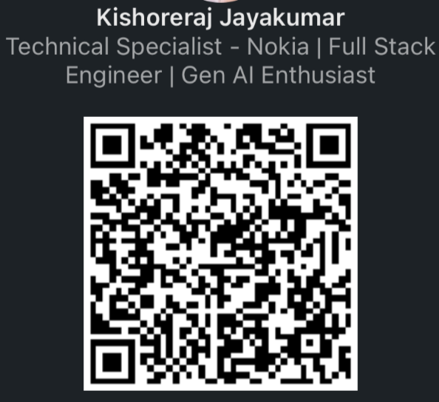

Thank You
Endorsements
https://www.linkedin.com/in/jkishoreraj/
Survey
https://forms.office.com/e/AkyCePZqbU

